Slide 2
Eric Hyyppa Board Chair, APTS and APTS Action, Inc. Director and General Manager, MontanaPBS

Slide 3
Tom Axtell General Manager Las Vegas PBS

Slide 4
Entrepreneurial
Non-Broadcast
Business
Development
Panel

Slide 5
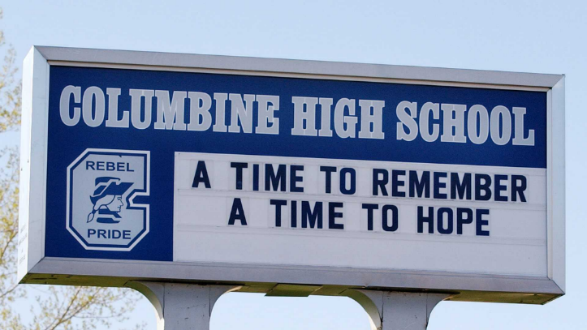
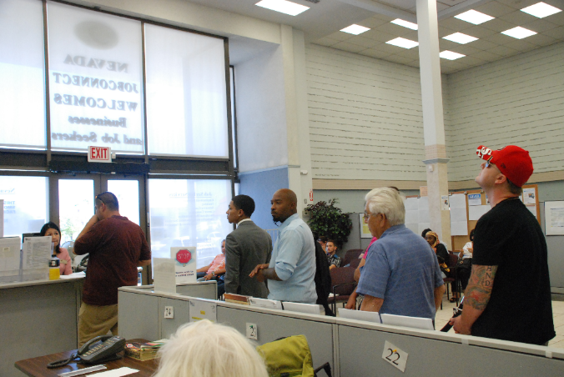
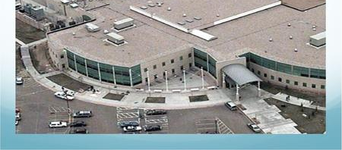
Response to Crisis

Slide 6
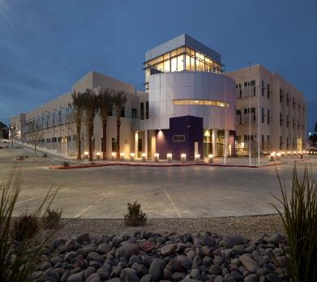
Digitized School Data for First Responders
SB 289 in 2001 requires public schools to provide updated emergency staff contacts, escape routes, hazardous materials, building blueprints, utility connections, etc., to emergency planners and first responders
District requires parent / employee contact info, release approvals, special needs data, etc.
Requirement is unfunded state mandate
CPB grant allows testing and deployment of prototype system

Slide 7
SEARS = School Emergency, Alerting & Response System

Slide 8
Evacuation Maps

Slide 9
Google Earth Site Images

Slide 10
Utility Location & Control
Electrical Shutdowns:
Main building electrical shutdowns and separate switch for HVAC shutdowns are located in the maintenance/custodian room or in the service area.
Three metal boxes need to be unlocked with a 3303 key then the lever handle should be pulled up.
HVAC Shutdowns:
Main building HVAC shutdown is located in the Chiller room.
Shelter in place HVAC shutdown is in the Chiller room.
To turn off pull all “on” levers to the “off” position.
Water Shutdowns:
Sprinkler control valve is located in the Riser room behind the Student Store.
Main building water shutdown – On the corner of Mustang and Peak Dr.
Unlock the chain with a 3303 key and turn two black valves next to metal boxes.

Slide 11
Special Student Needs
Student | Health Concern | Room | Adult Assigned | Supplies Needed | Heat Sensitive
A | Cancer | 3 | aa | Wheelchair | Yes
B | Cerebral Palsy | 255 | bb |  | Yes
C | Cancer | 51 | cc |  | Yes
D | Cerebral Palsy | 33 | dd | Wheelchair | No
E | Vision Impaired | 341 | ee |  | No
F | Asthma | 61 | gg |  | Yes
G | No Heat > 90 | 61 | hh |  | Yes

Slide 12
Datacast to Police Car

Slide 13
Doing Well by Doing Good Datacasting
Grant/Funding | Dollars | Year
Support Staff | $150,500 | Annual
DOJ Grant | $321,107 | 2010
CPB Datacasting Capital Grant | $89,539 | 2015
CCSD Capital Equipment Donation | $210,000 | 2015
CCSD Capital Equipment Donation | $292,000 | 2017

Slide 14
Great Recession
Notes:
Highest Unemployment Rate in the Nation
Highest Dropout Rate
Budget Cuts to Education
Need for industry diversification
Highest Foreclosure Rate in the nation
Grant from Bank of America $200,000 Neighborhood Builder

Slide 15
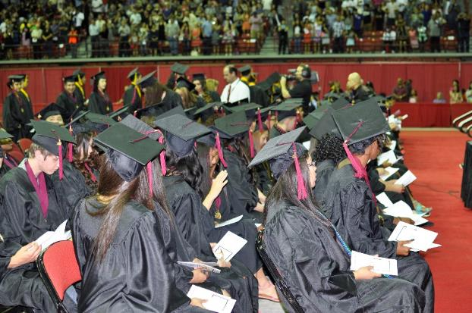
Station Capacity
Vegas PBS offering GED & TeacherLine
Existing online high school courseware
Learning Management System experience
Broadcast marketing
Hired training expert
Invested $350,000

Slide 16
Certificate Program Examples
Certified Electronic Health Records Specialist
Cisco Certified Network Professional
CompTIA™ A+ Certification Training
Certified Green Supply Chain Professional
Professional Bookkeeping with Quickbooks
Veterinary Assistant
Pharmacy Technician
Notes:
Over 5,000 courses and programs
457 Instructor or Mentor Led Industry Certifications
230 Self-Paced Learning Plans
Programs Tied to Governor’s Economic Development Plan
Custom Portals for Local Business & Industry Clients
Custom Portal for Nevada AHEC Programs

Slide 17
Partners Enlisted

Slide 18
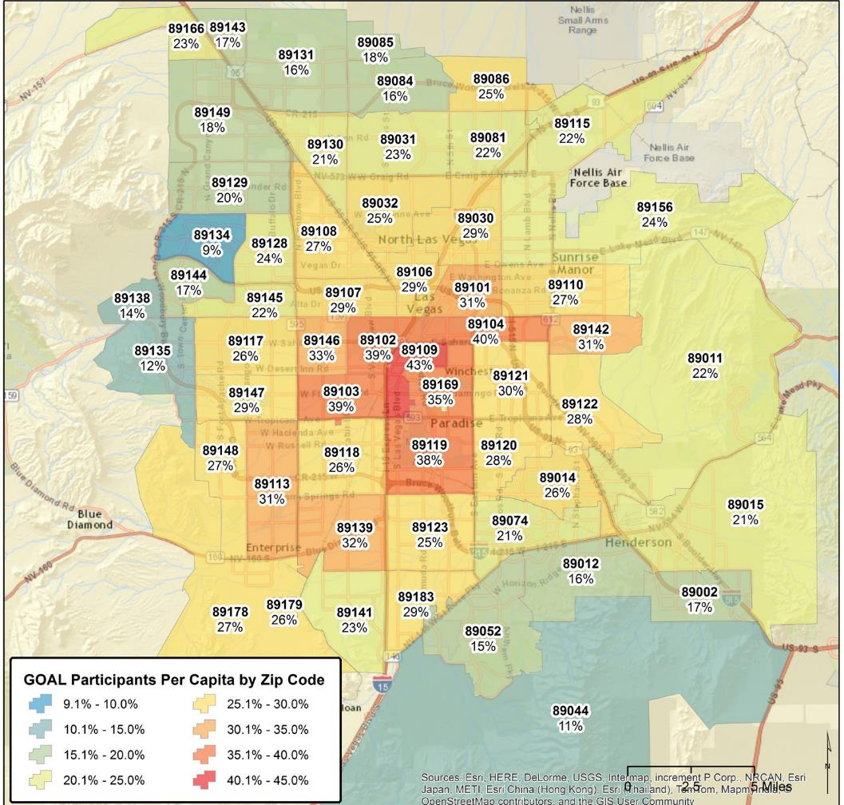
Benefiting Areas
With Higher Levels
Of Economic Stress

Slide 19
LouAnn & Tim Church (Yucca Mountain)
Laid off from Test site in 2010
Lost Home/Living in public housing
Started training programs with Vegas PBS in 2012
LouAnn – Medical Biller & Coder, hired within six months.
Tim – started in accounting program, switched to IT. Earned Cisco certification.
Combined income more than $150,000
Photo Credit: Las Vegas Review-Journal
And PW-2014-11-17-Gwynne-yucca

Slide 20
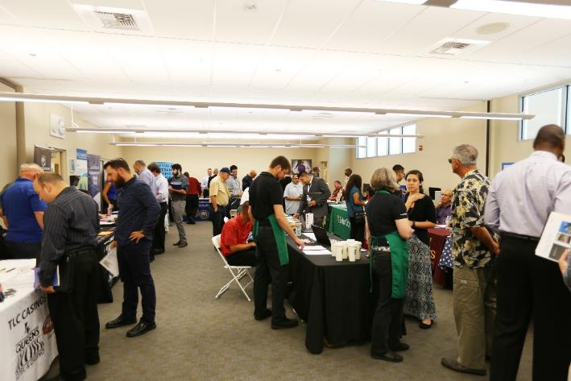
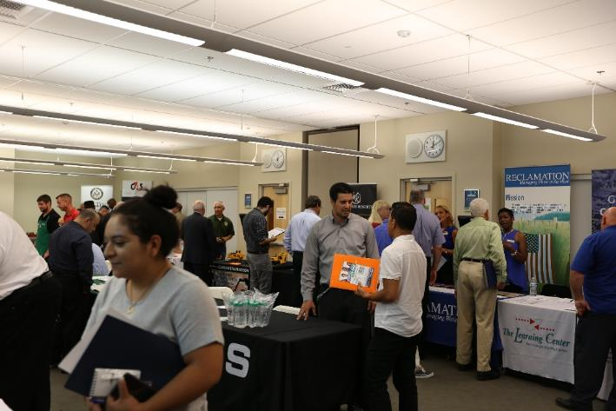
Veterans Hiring Events (3 per year)
5 hired on the spot
87 spot interviews
178 scheduled interviews
400 took Profiles career assessment

Slide 21
Meet Marty (Caesars)
ESL to Warehouse
Warehouse to Marketing
30% salary increase
First-time homebuyer & first generation in his family to own a home
Met career goal

Slide 22
Caesars Back-To-Work A Partnership with Caesars Foundation
Walter V. Long
ES
Mack Middle School
Chaparral High School

Slide 23
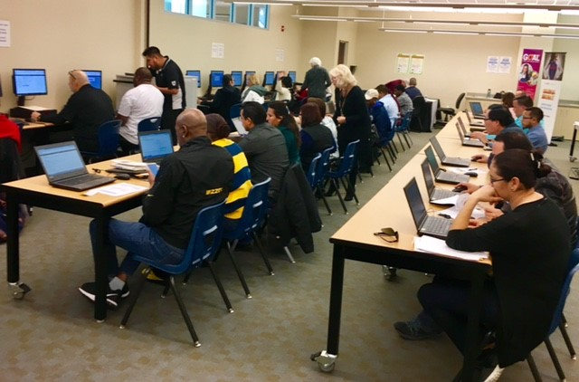
Clark County School District (Job Fairs)
12 monthly events
promoted on TV
542 applications
100+ enrolled in our online training

Slide 24
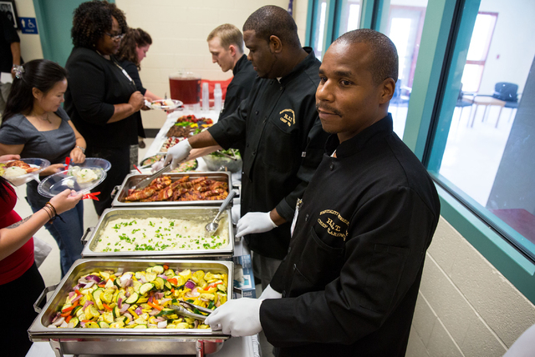
Reducing Recidivism Prisons, Hotels, & Non-Profits Work Together
High School Diploma + Health Card Certificate + ServSafe Food Manager Training & Exam
Red Rock Academy at Summit View –
a Juvenile Correctional Institute
13 Students - No Recidivism
10 x $20,656 = $206,560.00
Photo Credit: Las Vegas Review-Journal

Slide 25
Launch of Desert Meadows Area Health Education Center
Pipeline
Healthcare Professionals
Community

Slide 26
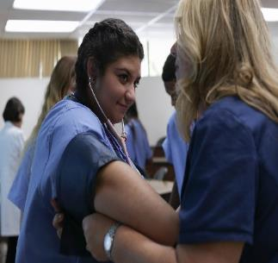
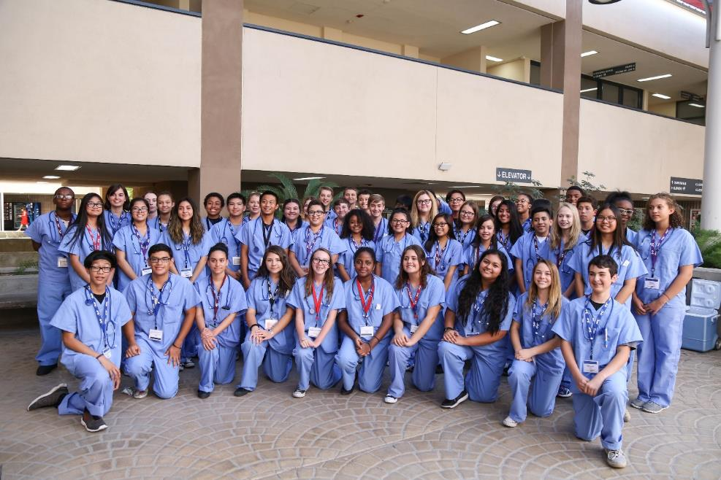
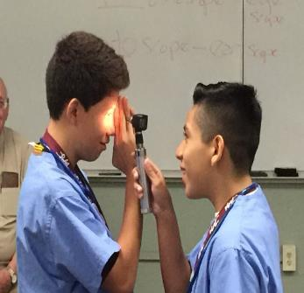
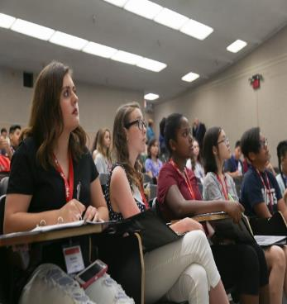

Slide 27
Desert Meadows AHEC Events
Human Papillomavirus (HPV) State Video Summit
Medicare Access and CHIP Reauthorization Act (MACRA) Merit-Based Incentive Payment System (MIPS) Conference
Medical Marijuana CLE
Robotics Conference CME

Slide 28
Doing Well by Doing Good Workforce
Program | 2011 | 2014 | 2017
Program Grants/Donations | $200,000 | $100,000 | $200,000
Training Course Fees |  | $2,400,000 | $2,600,000
AHEC Health Education Funding |  |  | $130,000
Community Block Development Grants |  |  | $70,000
Total Program Revenues | $200,000 | $2,500,000 | $3,000,000

Slide 29
Entrepreneurial
Non-Broadcast
Business
Development
Panel

Slide 30
Jerry Franklin President and CEO Connecticut Public Broadcasting Network

Slide 31
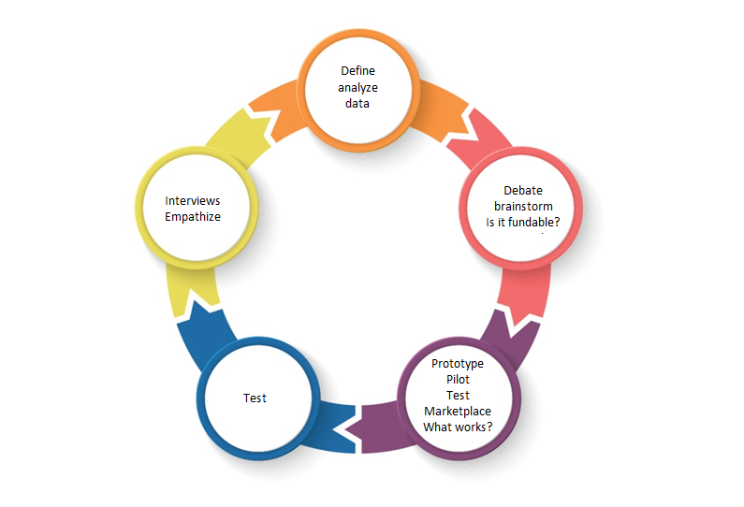
The Human-Centered Design Approach
As a framework for our work, we have adopted a research-based human-centered design approach. We are conducting audience interviews, collecting and analyzing the data, brainstorming revenue opportunities and prototyping new ideas. We will then test our hypotheses and create a myriad of opportunities to grow content production.

Slide 32
The Norwalk Innovation Center (Expanding Geographical Reach)
The Norwalk Innovation and Technology Center will serve as a hub through which community organizations and businesses can incubate ideas and sources to develop new content. The Center will offer entrepreneurial and engagement opportunities for community entities to host events forums, live-streaming and broadcast. Distribution partners include:
Norwalk Public Schools
Palace Production Center
Stamford Innovation Center
Moondog Productions (digital network partner, NYC)
Fairfield County News Bureau – WNPR, CPTV, WSHU, Connecticut Radio Network (podcast partner)
Veteran’s Training Center
Wall Street Theater (creative partner)

Slide 33
Rich Homberg President and CEO Detroit Public Television

Slide 34
The DPTV Engagement Grid

Slide 35
The DPTV Engagement Grid
Informed By
Collective Impact – FSG study on public television – 2011
Boston Consulting Group – White paper on engagement 2014
PreNups - 2012
Models of the Future – PBS – 2014
The Knight Foundation – 2008 - 2016
Atlantic Media Strategies - 2016
Various university and industry studies

Slide 36
The DPTV Engagement Grid
Five Key Issues
Where is the need/opportunity?
Where can DPTV unique serve?
Who are our stakeholders/partners – Where do they serve?
Where is the larger, long-term opportunity?
What are we going to do next? Next week?

Slide 37
DPTV Engagement Grid

Slide 38
DPTV Engagement Grid
Mission/Vision/Value

Slide 39
DPTV Engagement Grid
Our Foundation – Understanding and Serving The Need of Our Community
Mission/Vision/Value

Slide 40
DPTV Engagement Grid
Our Foundation – Understanding and Serving The Need of Our Community
What are the needs of our community?
Five Key Areas:
Children/ Education – Culture – Leadership/Public Affairs - Energy/Environment - Health
Mission/Vision/Value

Slide 41
DPTV Engagement Grid
DPTV’s Unique
Position/Assets
Our Foundation – Understanding and Serving The Need of Our Community
Mission/Vision/Value

Slide 42
DPTV Engagement Grid
DPTV’s Unique Position and Assets
Platforms
56.1, 56.2, 56.3
WRCJ
Web
Social pages
Email
Apps
Brand/Reputation
Staff/Skills
Staff size, skills
Production staff
Production capability
Revenue development team
Systems
Database development
Engagement execution
Affiliations staff
Live production
Events/Roadshow process
Doc production
How-to production
Bureau Chiefs
Roadshows
Facebook Live plan
Production team
Live production capabilities
Infrastructure
Bandwidth
Equipment
Studios
Production platforms
Partnership mindset
Existing partnerships
We are great partners/RPS
Financial strength
Content
Trust, vetted, transparent
Local
Series
Specials /Roadshows
Streaming
Pledge-type production
Documentaries
How-to
Celebratory
Short-form and long-form
Daily content
Curriculum-based/PSU
Existing initiatives
National
PBS Content
PBS platforms
PBS.org
PBS Learning Media
PBS Black Culture Connection
PBS Content-related
opportunities, events
Content from other partners
What content do we have
on the shelf?
What is in our library?
Audiences
Viewers
Listeners
Membership
Social
Databases
Key relationships
Existing partnerships

Slide 43
DPTV Engagement Grid
DPTV’s Unique
Position/Assets
Partners
Our Foundation – Understanding and Serving The Need of Our Community
What are the needs of our community?
Five Key Areas:
Children/ Education – Culture – Leadership/Public Affairs - Energy/Environment - Health
Mission/Vision/Value

Slide 44
DPTV Engagement Grid
Partners
Communities of interest
Key stakeholders
Thought leaders
Champions
Teachers
Parents
Universities
Government
PBS/CPB/MMG
Other stations
Funders
RPS
PreNups
Backbone organization

Slide 45
DPTV Engagement Grid
DPTV’s Unique
Position/Assets
Partners
Our Foundation – Understanding and Serving The Need of Our Community
What are the needs of our community?
Five Key Areas:
Children/ Education – Culture – Leadership/Public Affairs - Energy/Environment - Health
Mission/Vision/Value

Slide 46
DPTV Engagement Grid
On-going Initiatives and Commitments
DPTV’s Unique
Position/Assets
Partners
Our Foundation – Understanding and Serving The Need of Our Community
Mission/Vision/Value

Slide 47
DPTV Engagement Grid
On-going Initiatives and Commitments
One Detroit
Great Lakes Bureau
Detroit PBS Kids
Preschool U
Production
National Pledge
DPTV’s Unique
Position/Assets
Partners
Our Foundation – Understanding and Serving The Need of Our Community
Mission/Vision/Value

Slide 48
DPTV Engagement Grid
On-going Initiatives and Commitments
DPTV’s Unique
Position/Assets
Agenda – Our Current/On-Going Agenda
Partners
Our Foundation – Understanding and Serving The Need of Our Community
What are the needs of our community?
Five Key Areas:
Children/ Education – Culture – Leadership/Public Affairs - Energy/Environment - Health
Mission/Vision/Value

Slide 49
DPTV Engagement Grid
On-going Initiatives and Commitments
On-going, sustainable initiatives
One Detroit
Great Lakes Bureau
Detroit PBS Kids
Preschool U
Production
National Pledge
DPTV’s Unique
Position/Assets
Agenda – Our Current/On-Going Agenda
Partners
Our Foundation – Understanding and Serving The Need of Our Community
Mission/Vision/Value

Slide 50
DPTV Engagement Grid
DPTV’s Unique Position and Assets
On-going Initiatives and Commitments
On-going, sustainable initiatives
BHAG’s
Platforms
56.1, 56.2, 56.3
WRCJ
Web
Social pages
Email
Apps
Brand/Reputation
Staff/Skills
Staff size, skills
Production staff
Production capability
Revenue development team
Systems
Database development
Engagement execution
Affiliations staff
Live production
Events/Roadshow process
Doc production
How-to production
Bureau Chiefs
Roadshows
Facebook Live plan
Production team
Live production capabilities
Infrastructure
Bandwidth
Equipment
Studios
Production platforms
Partnership mindset
Existing partnerships
We are great partners/RPS
Financial strength
Content
Trust, vetted, transparent
Local
Series
Specials /Roadshows
Streaming
Pledge-type production
Documentaries
How-to
Celebratory
Short-form and long-form
Daily content
Curriculum-based/PSU
Existing initiatives
National
PBS Content
PBS platforms
PBS.org
PBS Learning Media
PBS Black Culture Connection
PBS Content-related
opportunities, events
Content from other partners
What content do we have
on the shelf?
What is in our library?
Audiences
Viewers
Listeners
Membership
Social
Databases
Key relationships
Existing partnerships
One Detroit
MiWeek/Mackinac
American Black Journal
Roadshows
Great Lakes Bureau
Detroit Performs/DP Live/Bravo
Detroit Journalism Cooperative
Detroit PBS Kids
Preschool U
Production
National Pledge Production
PBS Book View Now
When I’m 65
DPTV’s Unique Position and Assets
Agenda – Our Current/On-Going Agenda
Current Agenda/Commitments/Opportunities
Priorities – What’s important?
Evaluating/Adding new opportunities
Fit inside of the current agenda
Calendar/Timelines
Rules/Mindset/CI
Feeding other areas of the building
Finance/Development
Operations/Production
Partners
Communities of interest
Key stakeholders
Thought leaders
Champions
Teachers
Parents
Universities
Government
PBS/CPB/MMG
Other stations
Funders
RPS
PreNups
Backbone organization
Our Foundation – Understanding and Serving The Need of Our Community
What are the needs of our community?
Five Key Areas:
Children/ Education – Culture – Leadership/Public Affairs - Energy/Environment - Health
What are the community needs/opportunities in each of these areas?
What is important to our community today and going into the future?
Where does Detroit Public Television need to serve in each of these areas?
What is our role?
What are we committed to?
A Detroit-outward view/A Preschool-outward view
What are the sustainable national content areas – “Production as a business”
Mission/Vision/Value

Slide 51
Partnering with Michigan State University
Michigan’s Land Grant University
R1 – Research University – 1 of 3
Public television/radio license holder
Extension Services
Strong schools of education, social sciences and community
Nick Homberg is a senior – Don’t blow it.
Great people – All Izzo’s

Slide 52
Partnering with Michigan State University
Knowing your partner ahead of time
Being prepared
Finding the opportunity
Having a plan

Slide 53
Partnering with Michigan State University
Knowing your partner ahead of time
Faculty engagement
Knight Center for Environmental Journalism
NEA/NEH event
Medical School/Detroit connection

Slide 54
Partnering with Michigan State University
Being prepared
Seeing the opportunities at universities
Understanding the culture - Spartans Will!
Understanding MSU’s unique position
Plans for the Kids Channel
Preschool U initiative
DPS Relationship

Slide 55
Partnering with Michigan State University
Finding the opportunity
Spectrum

Slide 56
Partnering with Michigan State University
Having a plan
Talking to the top of the organization
Peace – We come in peace!
Presumption – No presumption!
Potential – Great potential!
Partnership – Could we build one?
The five keys - Next week? Next week!

Slide 57
Partnering with Michigan State University
Since our agreement
Keeping leadership at the table
Understanding the culture
Avoiding RPS/Reluctant Partner Syndrome
Mining the academics
Building plans with extension services
Seeking further commitment

Slide 58
What’s next with Michigan State University
Detroit PBS Kids
Launched 24/7 channel – MSU informed
President Simon and Leslie Rotenberg
helped launch
Preschool U – MSU adding content
Numerous shared efforts
Developing a staffing/funding plan

Slide 59
Teya Ryan CEO and President Georgia Public Broadcasting

Slide 60
Georgia Public Broadcasting
Education Initiatives
Teya Ryan, President & CEO

Slide 61
Georgia Studies Digital Textbook

Slide 62
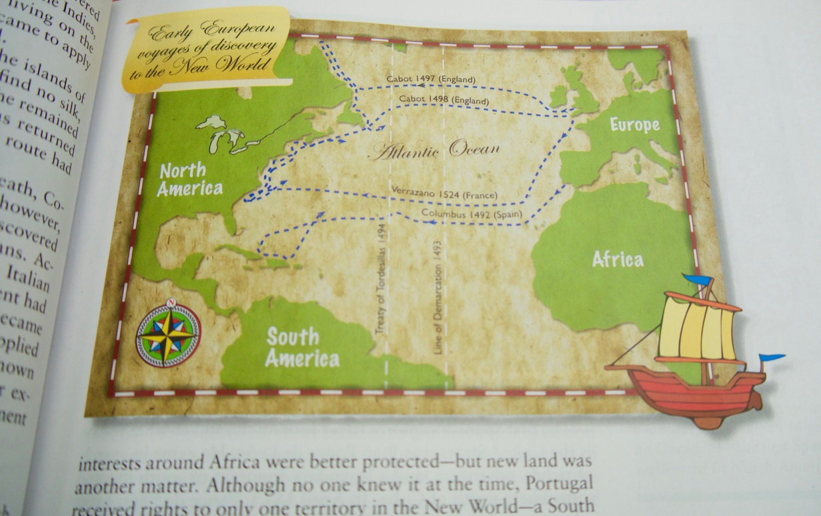
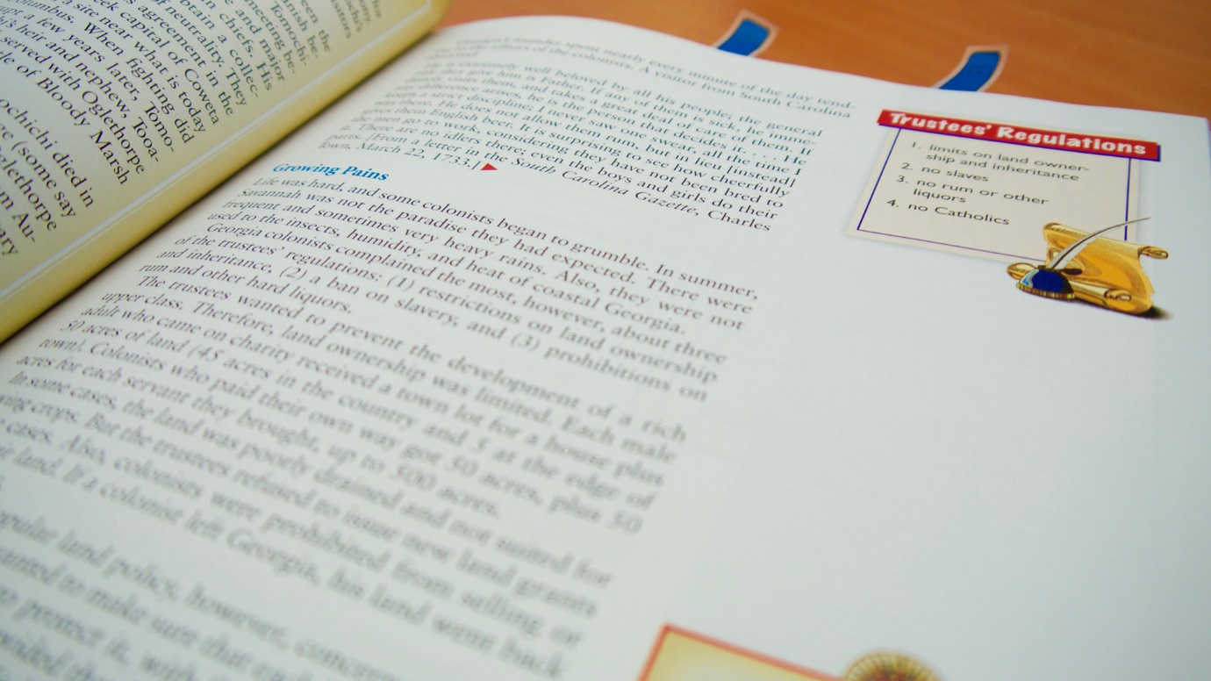
Georgia Studies Digital Textbook

Slide 63
Georgia Studies Digital Textbook

Slide 64
Georgia Studies Digital Textbook
34,855
264,955
Page views from
Page views from
July – December 2015
July – December 2016
660% increase from last year

Slide 65
Education Outreach
Two education outreach specialist travel the state providing free professional development to teachers
Conducted 350 school-based sessions since they started in August 2015
Have reached over 3,000 teachers

Slide 66
Cherokee Nation Virtual Field Trip

Slide 67
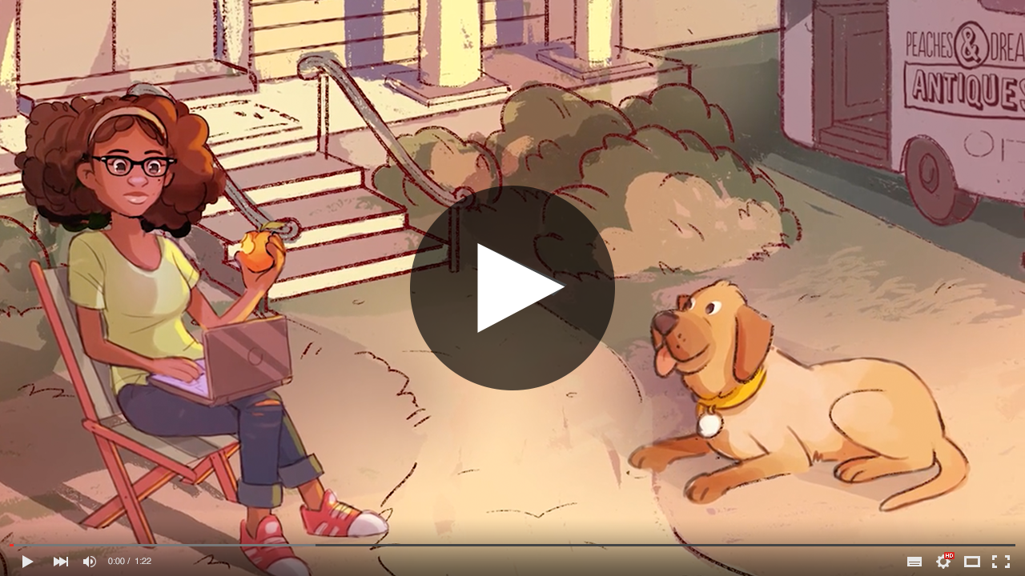
Georgia Race Through Time

Slide 68
Georgia Race Through Time
A new history adventure game from GPB
Aligned to Georgia standards
Leverages primary source documents and rich historical content
Designed to work across web, tablet, and mobile

Slide 69
Regents of Georgia -Textbook Project

Slide 70
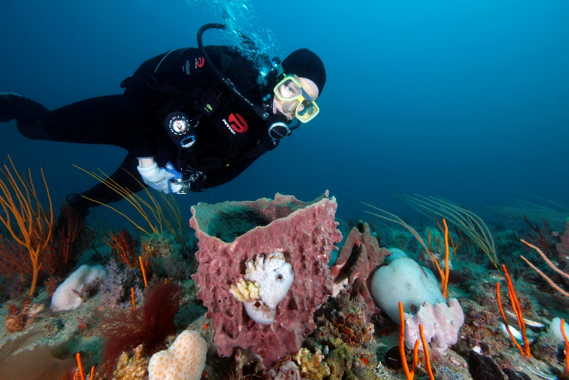
GPB Live Explorations: Gray’s Reef National Marine Sanctuary
Live streaming from the Georgia coast (Skidaway Island) on May 10th at 10:00 a.m.
Experienced divers and marine biology experts will answer students’ questions live.
Available on demand with classroom
resources for grades K-12!
www.gpb.org/grays-reef.

Slide 71
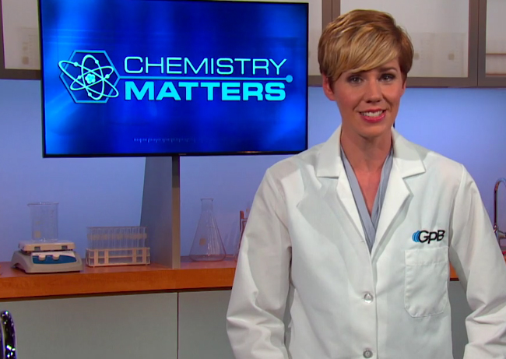
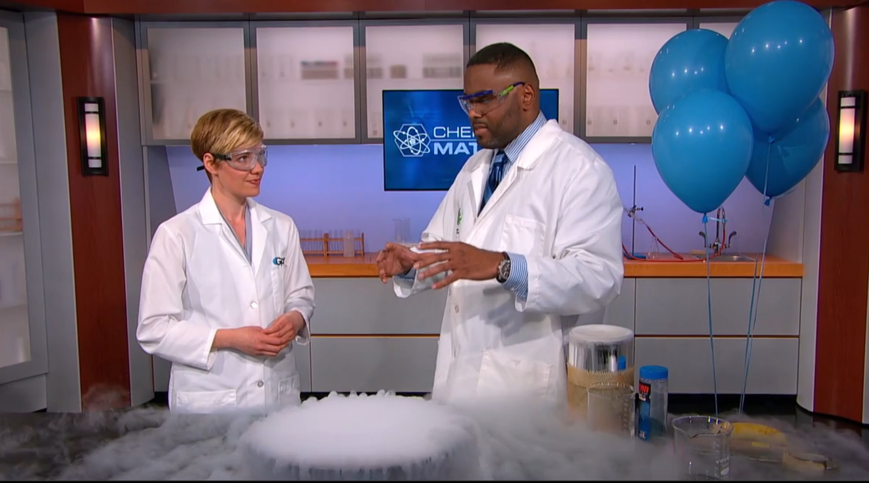
gpb.org/chemistry-matters

Slide 72
Chemistry Matters
New digital series for high school chemistry
Aligned to Georgia’s latest standards, developed by Georgia teachers
Twelve units of study, including supplemental materials for each topic
Coming soon: Physics in Motion!

Slide 73
Dinoventures

Slide 74
Station Entrepreneurship: Models of Non-Broadcast Business Development
Tom Axtell
General Manager Las Vegas PBS
Rich Homberg
President and CEO
Detroit Public Television
Jerry Franklin
President and CEO
Connecticut Public Broadcasting Network
Teya Ryan
CEO and President
Georgia Public Broadcasting

