Slide 1
Emil Mara Vice President, Finance, Administration and Membership America’s Public Television Stations

Slide 2
APTS Resources and Efforts
What Works case studies
Public safety initiatives
State funding resources

Slide 3
The Numbers
$1 billion in foundation grants to media
Nearly $50 million in federal grants to public media

Slide 4
The Numbers
$1 Billion in foundation grants to media
Nearly $50 Million in federal grants to public media

Slide 6
Meegan White Project Director Grant Center for Public Media mwhite@apts.org / 202-654-4214

Slide 7
The Grant Center for Public Media
A Partnership of:

Slide 8
Media Impact Funders and Foundation Center Study
$5.5 billion to media projects from 2009 to 2013.
Annual funding has increased from $921 million in 2009 to $1.2 billion in 2013.
Five categories of projects:
Journalism, News and Information
Media Access and Policy
Media Applications and Tools
Media Content and Platforms
Telecommunications and Infrastructure

Slide 9
Media Impact Funders and Foundation Center Study
$697 million to public media projects from 2009 to 2013.
Study contains a wealth of very detailed information.
Breakdown of funding to public media on the Grant Center’s website.

Slide 10
Federal Giving to Public Media, 2016
Federal Grants to Public Media, 2016
Federal Agency | Total Dollars (# of grants)
Department of Education | $25,700,000 (2)
National Science Foundation | $12,528,046 (24)
National Endowment for the Humanities | $5,849,193 (19)
National Endowment for the Arts | $2,837,500 (62)
NASA | $2,000,000 (1)
Institute for Museum and Library Services | $314,601 (2)
Grand Total | $49,229,340

Slide 11
We Offer:
Searchable database including hundreds of grant opportunities relevant to public media
Timely alerts about new and upcoming grants
Webinars that connect you with funders and funding trends
Private consultations and expert advice
Grant writing service
. . . and more!

Slide 12
Let Us Help You Find the Grants
Members download our guides to find grants for:
American Graduate projects
Corporate Foundations
National Science Foundation
Custom Prospect Research
Tailored to your station’s needs

Slide 13
Funding Trends to Watch
How will the foundation world respond to threats to federal funding?
We are creating resources for you:
Production funding
Environmental education
Emergency preparedness
Journalism

Slide 14
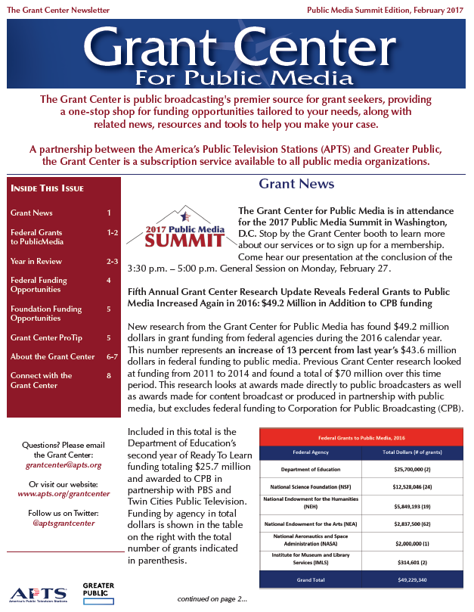

Slide 15
Highlights
Foundation funding for media projects is on the rise.
Federal grants to stations represent a 13% increase in funding since last year.
NSF, NEH, NEA remain top funders to public media (not counting Ready To Learn).
Grant Center webinars give members opportunity to connect with Program Officers.
New foundation funding opportunities on the horizon
Grant Center provides the resources to help our members take advantage of these funding opportunities.

Slide 16
Sign Up Today!
$2,900 per year
www.apts.org/grantcenter/signup
Meegan White
mwhite@apts.org
202-654-4214
Anthony Collebrusco
acollebrusco@apts.org
202-654-4207

