Slide 1
Incentive Auction Transition APTS Public Media Summit
February 27, 2018

Slide 2
Disclaimer
These slides, prepared by Commission staff, present an unofficial summary of FCC rules, orders, and public notices. Nothing herein is intended to supersede any provision of the Commission's rules, orders or public notices. Should this summary vary from the Commission's rules, orders or public notices, the official adopted documents govern.

Slide 3
Status of Post-Auction Transition

Slide 4
The Transition Is Well Underway
10 months into 39 month transition period.
Winning bidders received proceeds.
Channel sharers implementing sharing.
Construction projects underway.
Millions of reimbursement dollars paid.
Transition Scheduling Plan performing, including flexibility for modifications.

Slide 5
Winning Bidders and Channel Sharing Stations
175 winning broadcast bidders; over $10 billion in auction proceeds paid on July 20, 2017.
133 winning bidders indicated an intent to enter into a channel sharing agreement.
97 stations have filed applications for a CP for shared facilities, 93 of those have been granted, and 48 implemented.
41 stations have ceased operations.
Notes:
.
33 stations have filed applications for a CP for shared facilities and 26 of those have been granted and 6 implemented.
CP applications for shared facilities must be filed by Nov 24, 2017, 60 days prior to t

Slide 6
Repacked Station Construction Projects
Construction Permit applications for most repacked stations filed July 12, 2017.
First Priority Window – to resolve extraordinary technical challenges, population loss in excess of 1%, and displaced ineligible Class As – closed Sept. 15, 2017.
Second Window – requests for expanded facilities or alternate channels – closed Nov. 2, 2017.
Granted 52 stations Phase Completion Date modifications – 50 moving earlier, including 44 before Phase 1 and 4 into Phase 1.

Slide 7
Additional Transition Support for Stations
Lifted the freeze on minor mods to provide flexibility for non-repacked stations and stabilize data prior to Special Displacement Window – Nov. 28 to Dec. 7, 2017.
Granted interim relief via Special Temporary Authority to 280 LPTV/translator stations displaced as wireless operators commence operations in the 600 MHz Band prior to opening of a Special Displacement Window.

Slide 8
Low Power and TV Translator Stations
Special Displacement Window for displaced LPTV/translator stations – Apr. 10 to May 15, 2018.
Channel Study released Feb. 9, identifying locations where LPTV/translator stations likely cannot propose facilities due to the presence of:
non-displaced LPTV/translator stations or permittees;
full power and Class A television stations; or
land mobile operations.
Webinar: in-depth review of the Channel Study and its assumptions scheduled for Feb. 28 at 1 PM https://www.fcc.gov/news-events/events/2018/02/lptvtranslator-special-displacement-window-webinar

Slide 9
Looking Forward
File Form 387 to report transition progress, quarterly on April 10, 2018, and at milestones.
Phase One testing date Sept. 14, 2018, and completion date Nov. 30, 2018.
Phase Two testing date Dec. 1, 2018, and completion date April 12, 2019.

Slide 10
Reimbursement Process and Resources

Slide 11
Reimbursement Funds Are Available and Flowing
$1 billion allocated on Oct. 19, 2017 (62% of total estimate for NCEs).
Stations and MVPDs have been able to draw down against their initial allocation by submitting invoices for eligible costs incurred.
Approved invoices are paid in full up to the allocation amount (not $0.62 on the dollar).
11
Notes:
Unlike broadcasters who are eligible for reimbursements, the FCC cannot predetermine which MVPDs will incur reimbursable costs. After an MVPD submits a cost estimate, the FCC will add them to the list of payment applicants and they may submit their Form 1876.

Slide 12
Looking Forward
We continue to monitor need for an additional allocation.
File revised estimates if plans change.
Both increases and decreases to estimates should be filed.
Verified revised estimates will be used to calculate the second allocation.

Slide 13
Reimbursement Resources
To assure prompt payment, it is important to be sure invoices are correctly submitted
FAQs and other resources available to help with forms: http://www.fcc.gov/incentiveauctions/reimbursement
Reimbursement Help Desk: reimburse@fcc.gov or (202) 418-2009.
13
Notes:
Unlike broadcasters who are eligible for reimbursements, the FCC cannot predetermine which MVPDs will incur reimbursable costs. After an MVPD submits a cost estimate, the FCC will add them to the list of payment applicants and they may submit their Form 1876.

Slide 14
Helpful Hints For Reimbursement Submissions
Ensure the data entered in Form 399 matches the invoice for: vendor name, EIN/TIN; invoice date, number, due date; dollar amount; and station name, call sign or facility id.
Upload an invoice only once for the first line item. It can later be associated with multiple line items using a drop down menu.
Do not delete an invoice unless instructed to do so. Instead upload a new invoice if needed. The system will use the most recent version.
Ensure the “Reimbursement Contact” identified on Form 399 is accurate. Timely respond to requests for information from the fund administrator. Avoid allowing those emails to be diverted as spam.
If an invoice is divided among multiple entities document how it is divided and the reason.
If requesting a partial payment (e.g., upgrades), include a cover letter identifying the reimbursement amount requested.
Submit invoices when they are ready even if others are under review. Invoices are reviewed individually as they are received.

Slide 15
Viewer Education Resources
15

Slide 16
Consumer Outreach Goals
Complement station notice obligations.
Leverage consumers’ reliance on FCC resources.
Prioritize hard-to-reach populations.
21

Slide 17
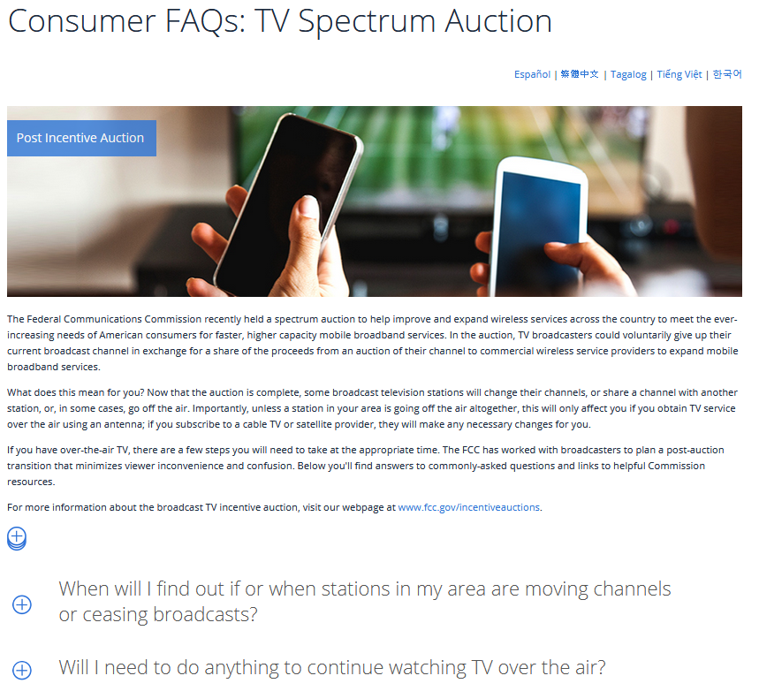
Q&A/Consumer Center
English and Spanish (other languages in process)
Downloadable
22

Slide 18
Re-scan Tutorial “PSA”
23

Slide 19
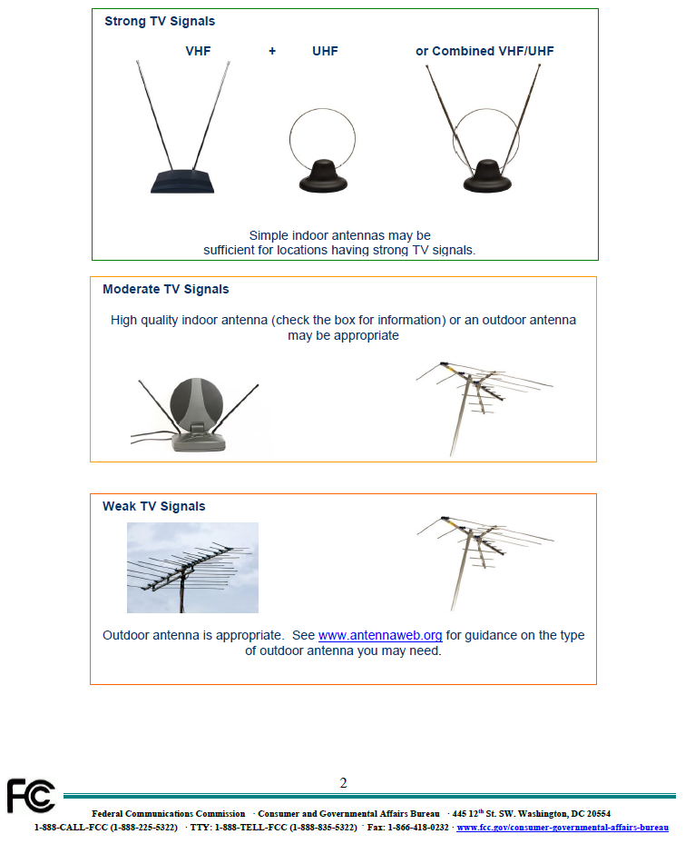
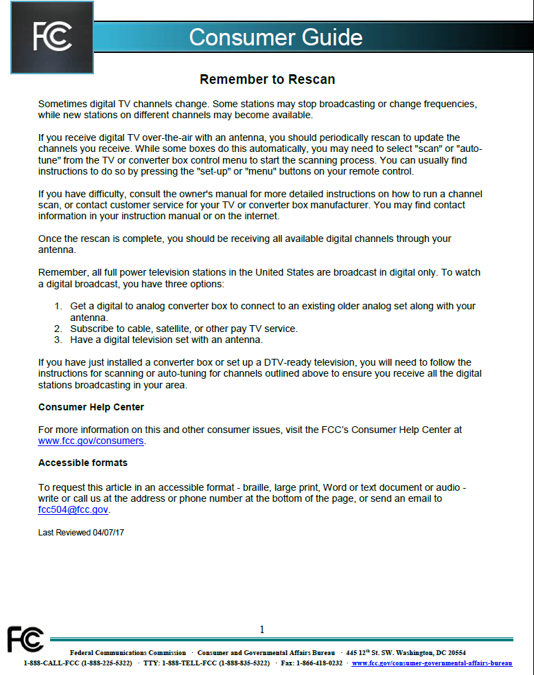
Consumer Guides
24

Slide 20
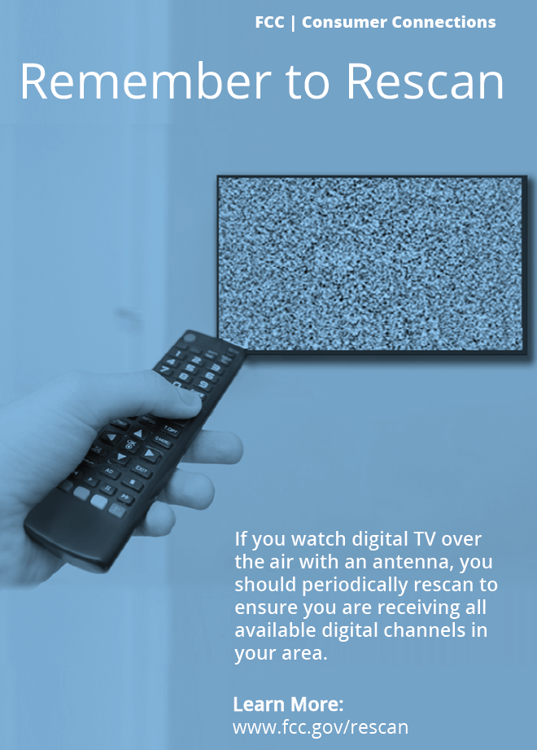
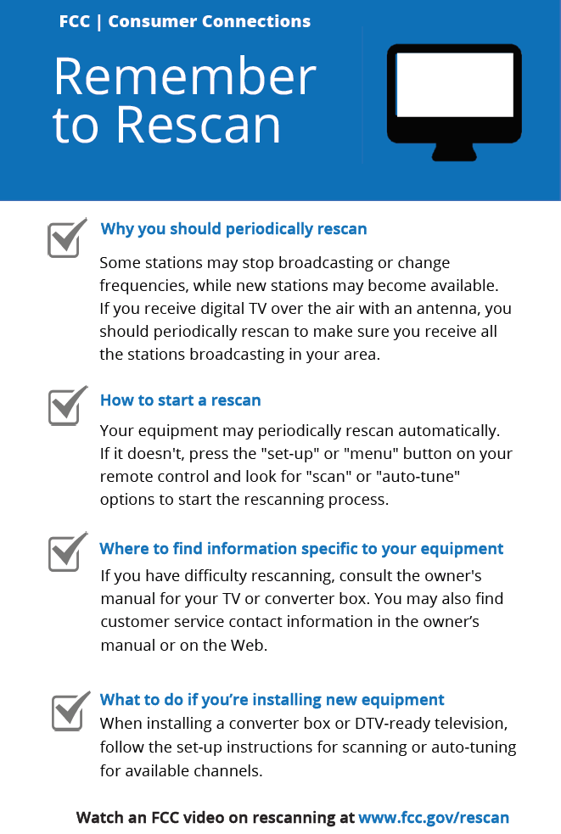
Consumer Tip Cards
25

Slide 21
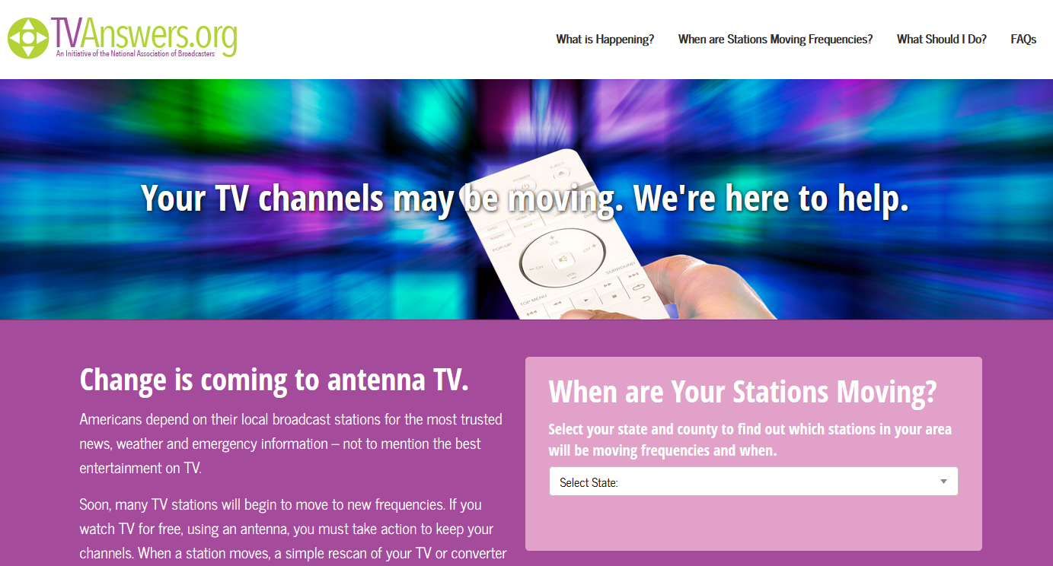
TVAnswers Initiative (NAB)
26

Slide 22
Questions?
27

