Slide 1
Susi Elkins
Director of Broadcasting and General Manager
WKAR

Slide 2


Slide 3
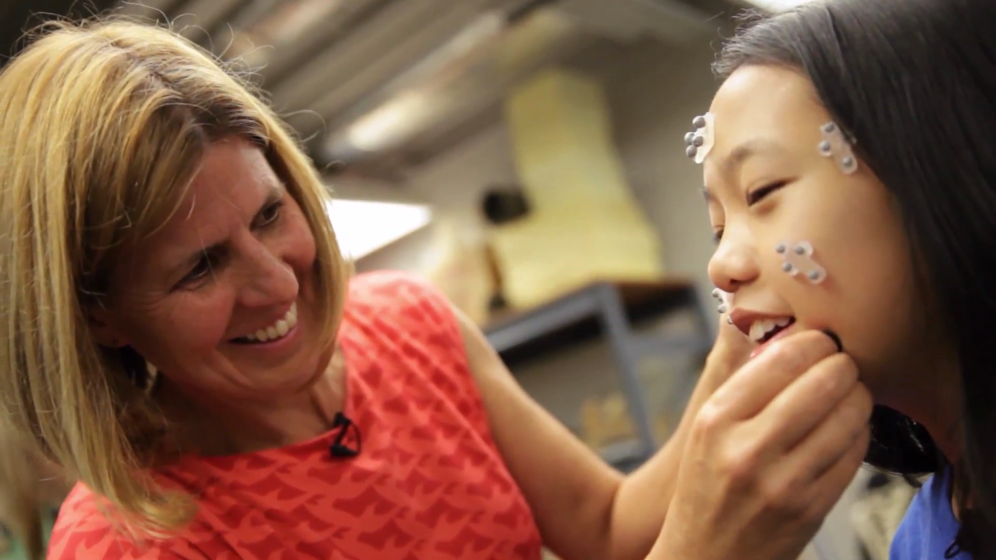

Slide 4


Slide 5


Slide 6


Slide 7


Slide 8



Slide 9


