Slide 1
Red Grasso Director FirstNet NC Fred Engel Senior Director, Technology UNC-TV

Slide 2
Saving Lives with Next Gen TV Alerting
Advancing the analog pager for faster emergency response
Fred Engel
Sr. Dir. of Technology
UNC-TV
Red Grasso
FirstNet SPOC
NC DIT
Page: 1

Slide 3
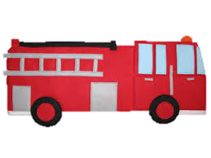
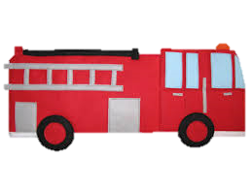
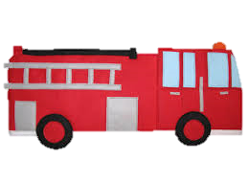
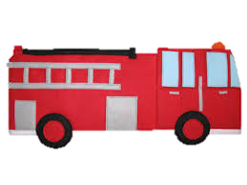
Kitchen Fire dispatch
5 Tones for dispatch to 9 units – 26 Seconds
Voice begins only after all tones have sounded
11 seconds to read unit numbers
Location announced 42 seconds after alert initiated
Full alert takes ~67 seconds
4102
4002
4034
4125
3735
4024
4027
4114
3720
Page: 2

Slide 4
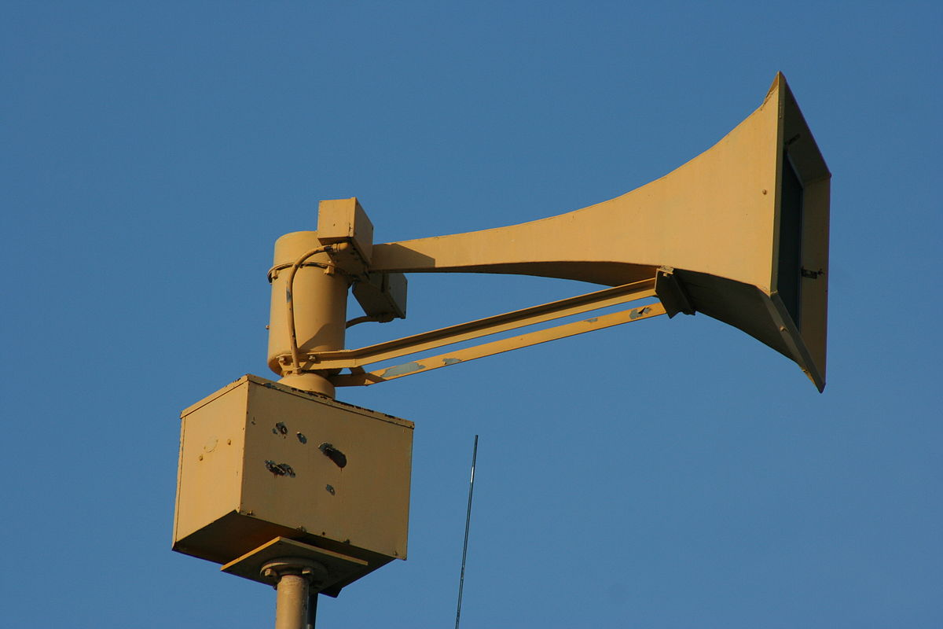
Tone alerting
Technology from 50+ years ago
70% of firefighters are volunteers
Volunteers might not be located at the fire station
Page: 3

Slide 5
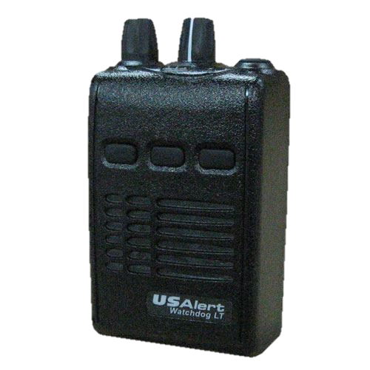
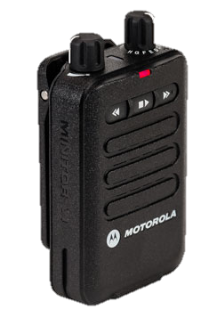
Today’s analog pagers
Tone & Voice pager
Extremely reliable & durable
Most have no display – voice only
Listen to on-scene radio traffic
Page: 4

Slide 6
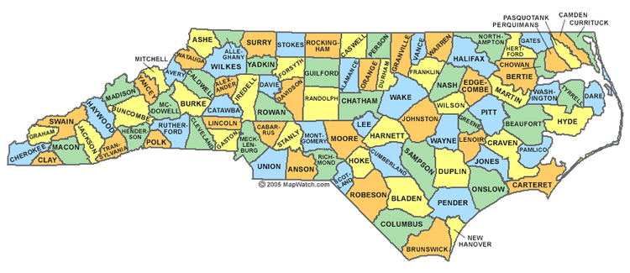
Coverage designed for the response area
County level is common
Every county is a different shape and size
Each system is separate
Page: 5

Slide 7
Government Document
This slide left intentionally blank
Page: 6

Slide 8
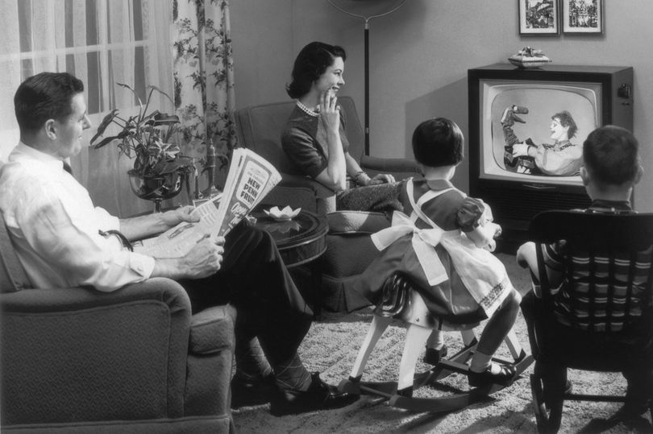
Television Today
DTV standard adopted in 1995
DTV transition completed in 2009
Page: 7

Slide 9
Digital Television Tomorrow
ATSC 3.0 “Next Gen TV”
Quality reception for moving receivers (watch tv from your limo)
IP based
Voluntary adoption
Page: 8

Slide 10
What is Datacasting
Unused bandwidth for other needs
Sending one-way data using the existing tv transmission
Data can include text, video,
audio, files, etc.
Page: 9

Slide 11
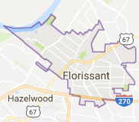
Next Gen TV Alerting
​
4034, 4024, 4125, 4114,3735, 3720, 4027, 4002, 4102, Respond to a first alarm,
Florrisant, kitchen,
450 Naomi Ave. cross street of Bobbinray,
respond on tac 10
4102
4034
3735
4125
4024
3720
4002
4027
4114
Page: 10

Slide 12
Datacast Paging Benefits
High Tower & High Power
Infrastructure already exists
Instantaneous
Encrypted
Scalable bandwidth
Simultaneous dispatches
Maps, preplans, ICS forms, audio, video, etc.
Page: 11

Slide 13
Current Status
UNC-TV is transmitting dispatches
Proof of concept report this summer
Engaged with local fire departments
Fred Engel
UNC-TV
fengel@unctv.org
919-549-7035
Red Grasso
FirstNet SPOC
Red.Grasso@nc.gov
919.961.1131
White paper available at https://ncbroadband.gov/datacastpaging
Page: 12

