Slide 1
Paul Siefken President and CEO The Fred Rogers Company

Slide 3
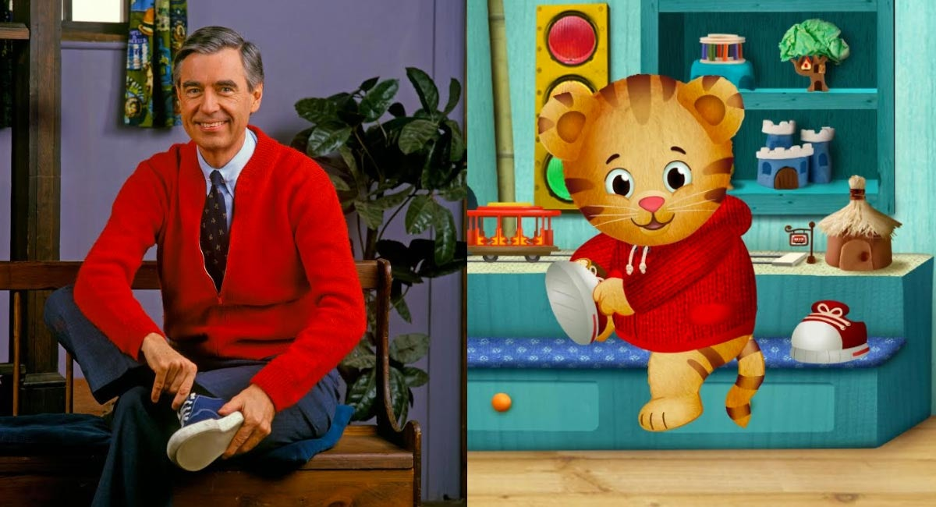
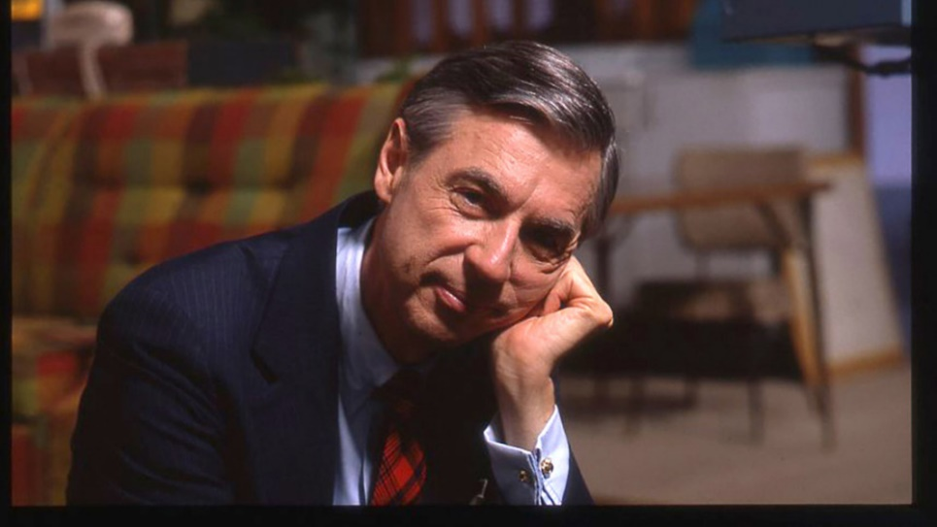
Daniel Tiger’s Neighborhood/
Mister Rogers’ Neighborhood
Feb. 26 – March 2 on PBS KIDS
Mister Rogers: It’s You I Like
Television Special
March 6 on PBS Stations
Won’t You Be My Neighbor?
Documentary
June 8 in Theaters

Slide 4
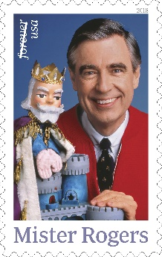
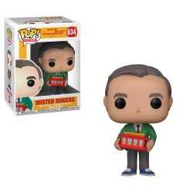
Mister Rogers Forever Stamp
March 23
FredRogers.org/MRN50
Mister Rogers Figurines

Slide 5
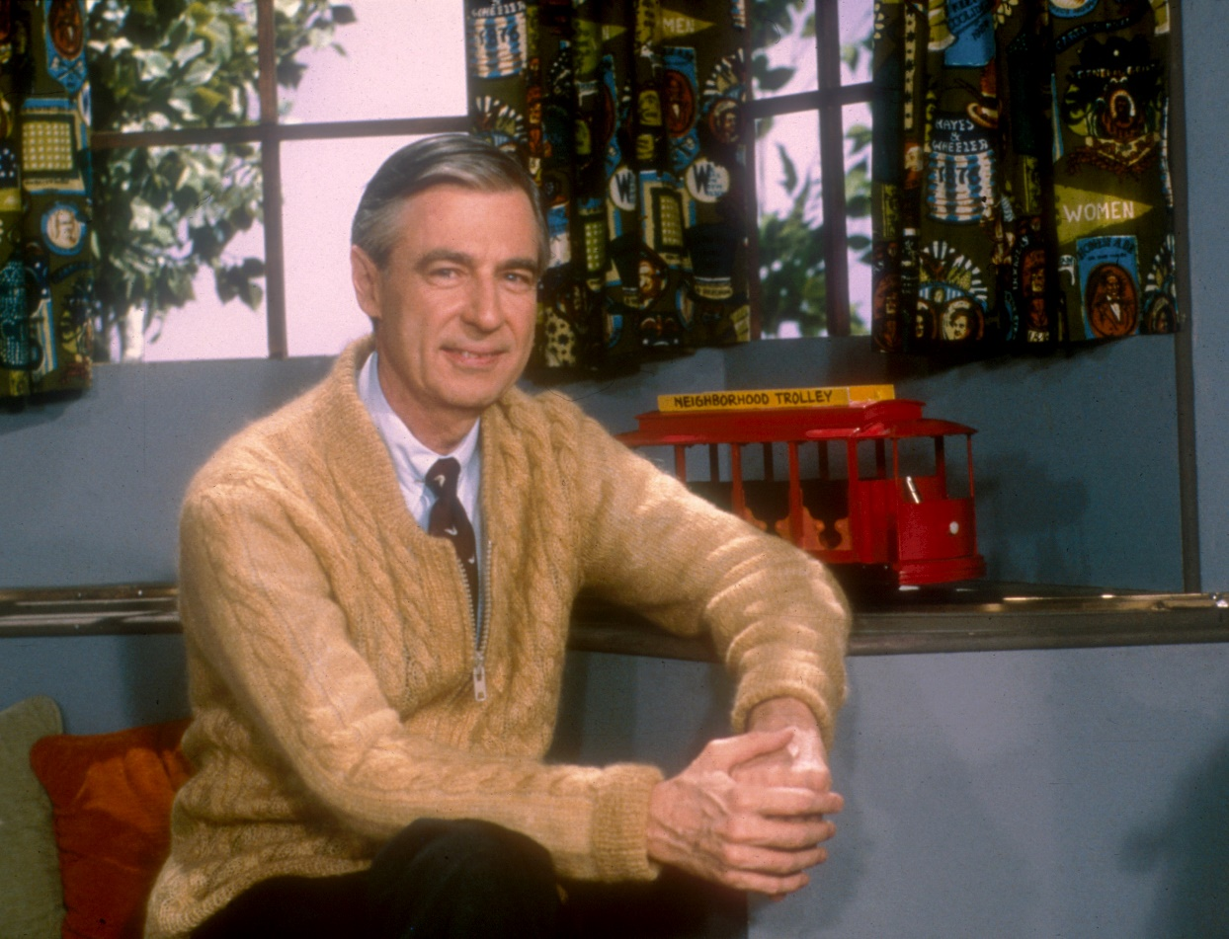

Slide 13
Viewers Like You

Slide 14
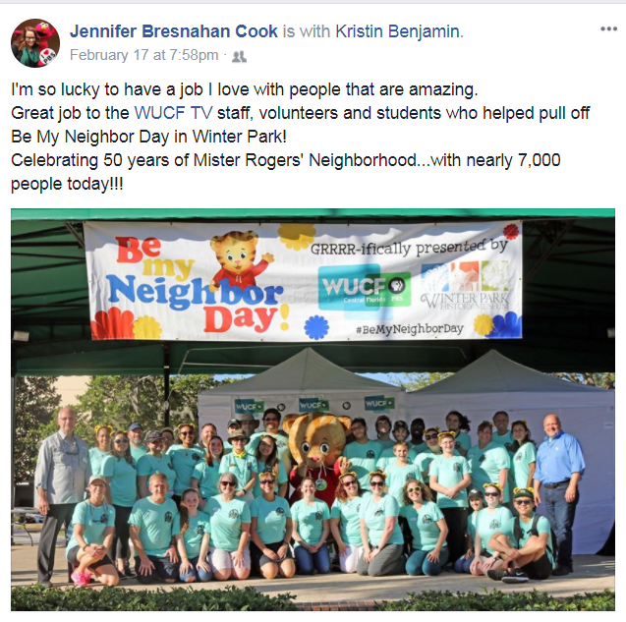

Slide 15
Thank You

