Slide 1
Neal Shapiro President and CEO WNET

Slide 2
APTS Summit 2018 the power of public media

Slide 3
Building community

Slide 4
Bridging National Issues to Local Communities
Content Sharing
Focusing on Issues That Truly Matter
Tackling Complex National Issues

Slide 5
Content Sharing

Slide 6
Legacies of War & Veterans Content Sharing Initiative

Slide 9
“Thank you so much for providing us with these two outstanding documentaries. And big, fat additional thank you’s for providing clean versions that can be customized for local markets.”
– WGCU, Southwest Florida

Slide 10
American Graduate Stories of Champions

Slide 11
115 Unique Stations • 14 Non-Station Entities
300+ Individual Users • 275+ Pieces of Content

Slide 12
“Wavelength is a dream come true for local stations and their needs.”
www.WavelengthPublicMedia.org

Slide 13
We focus on Issues that truly matter

Slide 14
Multi-Platform Initiatives

Slide 15
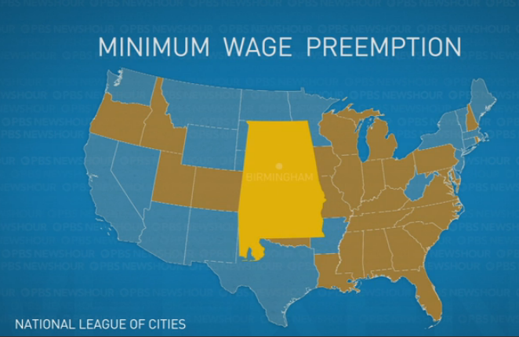
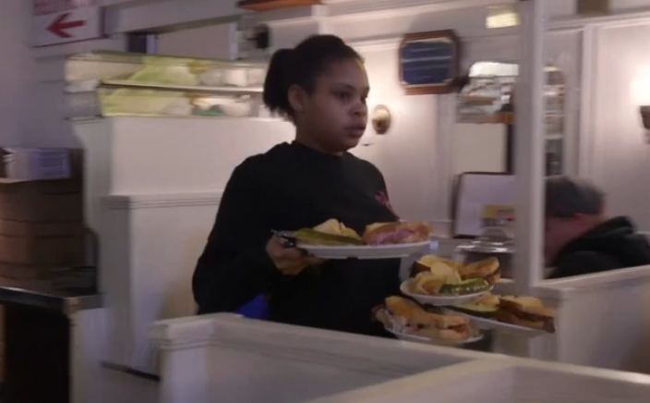
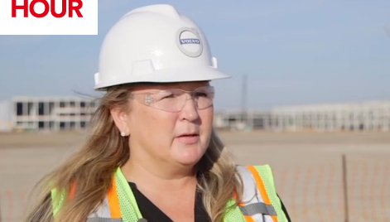
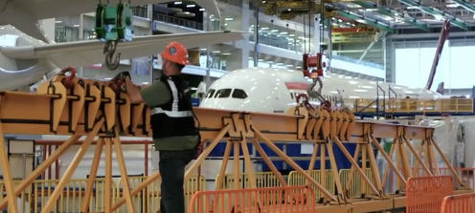

Slide 16
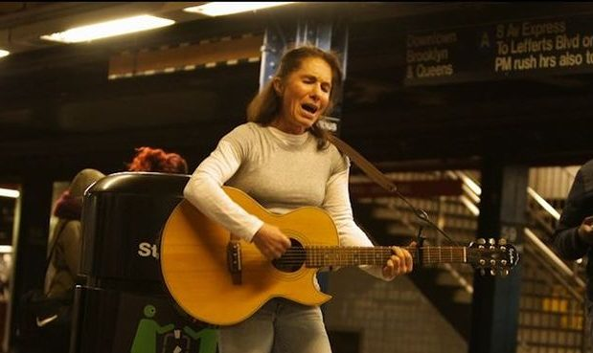
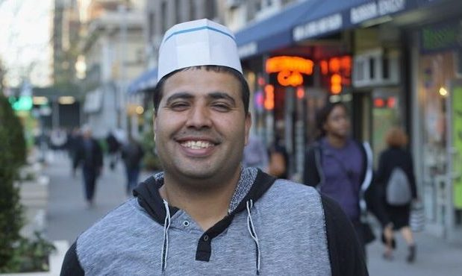

Slide 17
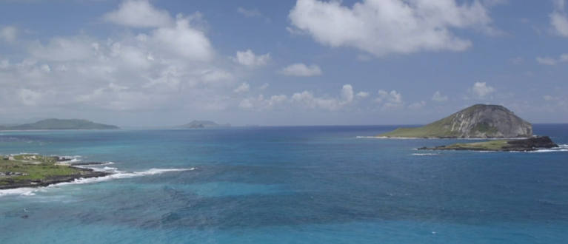
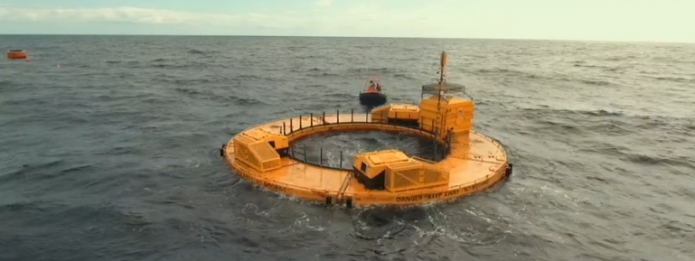
Peril and Promise: The Challenge of Climate Change

Slide 18
Local Station Reach & Impact – Station Grants
Chasing the Dream (est. 2015)
269 Reports; Reach: 12 MM+ Viewers
20 Station Grants
Total Social Media Engagements: 29K+
Total Social Video Views: 1.7 MM+

Slide 19
Sparking dialogue

Slide 20
The Talk: Race in America & America in Black & Blue: A PBS NewsHour Weekend Special

Slide 21
