Slide 1
Meegan White Project Director, Grant Center for Public Media America’s Public Television Stations

Slide 2
The Grant Center for Public Media
A partnership between:

Slide 3
Foundation Giving to Media
Updated research from Media Impact Funders finds an average of over $1 billion per year in media grants between 2009 and 2015
Total giving increased each year
Most recent data:
$1.2 billion in funding for over 22,000 grants in 2014
$1.3 billion in funding for over 33,000 grants in 2015
Trends indicate an increase in annual funding for 2016

Slide 4
Federal Funding $ to Public Media in 2017
Federal Grants to Public Media, 2017
Federal Agency | Total Dollars (# of grants)
Department of Education | $27,700,000 (2)
National Science Foundation (NSF) | $21,550,044 (23)
National Endowment for the Arts (NEA) | $2,495,000 (63)
National Endowment for the Humanities (NEH) | $2,112,569 (14)
NASA | $2,000,000 (1)
Institute for Museum and Library Services (IMLS) | $372,074 (2)
National Archives and Records Administration (NARA) | $303,655 (2)
Grand Total | $56,533,342

Slide 5
What we offer
Searchable database of hundreds of grants tailored to public media
Timely alerts about new and upcoming grants
Webinars that raise your grant writing skills and connect you with funders

Slide 6
What we offer
Private consultations and expert advice
Custom prospect research
Grant writing service
…and more!

Slide 7
Let us help you find grants!
Download our Newest Funding Guides
Production Funding
Journalism Funding
Emergency Preparedness Funding
Custom Prospect Research
Tailored to your station’s needs

Slide 8
What’s new this year?
New Website
Smarter searching
Save your prospects
See related content
Grant deadline calendar
Twitter feed embedded
Professional Development Webinar Series – Measuring Impact
More One-on-One Consultations

Slide 9
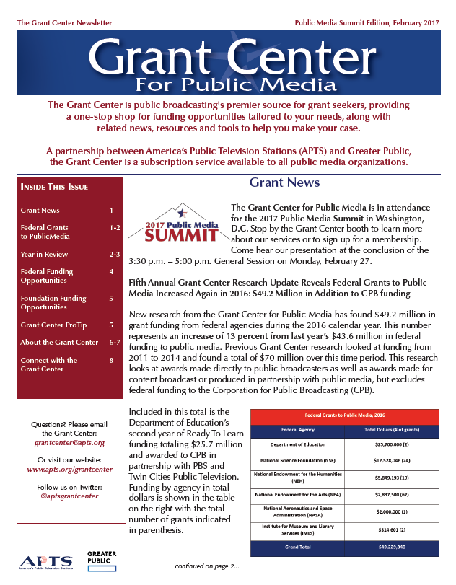

Slide 10
Join our next webinar!
Education Innovation Planning Grants
$500,000 in station planning grants from CPB
$10,000 grants available to 50 stations
Thursday, March 15, 2018
1:00 P.M. – 2:00 P.M. EST
This webinar is open to all stations.
Register at www.apts.org/grantcenter.

Slide 11
Highlights
Grant Center resources help stations get their share
Connect directly with funders via webinars
Enhanced searching of grant database
Funding guides in priority areas
Professional development for your grant writers
One-on-one consultations
Custom research for your project

Slide 12
Highlights
Federal funding remains steady, with some priorities shifting
NSF, NEH, NEA remain top funders to PTV (not counting Ready To Learn)
Foundations are giving over $1 billion annually to media (and trending up)

Slide 13
Sign up today!
$2,900 per year
https://apts.org/content/grant-center-sign-form
Meegan White mwhite@apts.org 202-654-4214 | Anthony Collebrusco acollebrusco@apts.org 202-654-4207

