Slide 1
Jon Abbott
President and CEO
WGBH

Slide 2
Mission Driven. Purpose Built.
Public Media and Education

Slide 3
Educational Gaps
2
Over 50% live in poverty
1 in 10 is an English language learner (1 in 4 by 2025)
13% in special education programs
Early Childhood
Center-Based Care
4th Grade Avg. Reading Score,
NAEP 2015
8th Grade Avg. Science Score,
NAEP 2015
High-income
Low-income
Poor
White
Hispanic
Black
Not Free/
Reduced Lunch
Free/
Reduced Lunch

Slide 4
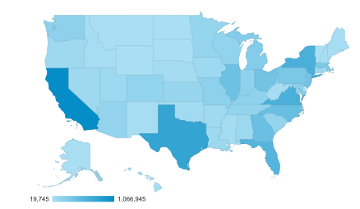

PBS LearningMedia
3
8.5M Users in 2017
Heat Map of PBSLM Usage 2017
U.S. Child Population by State

Slide 5
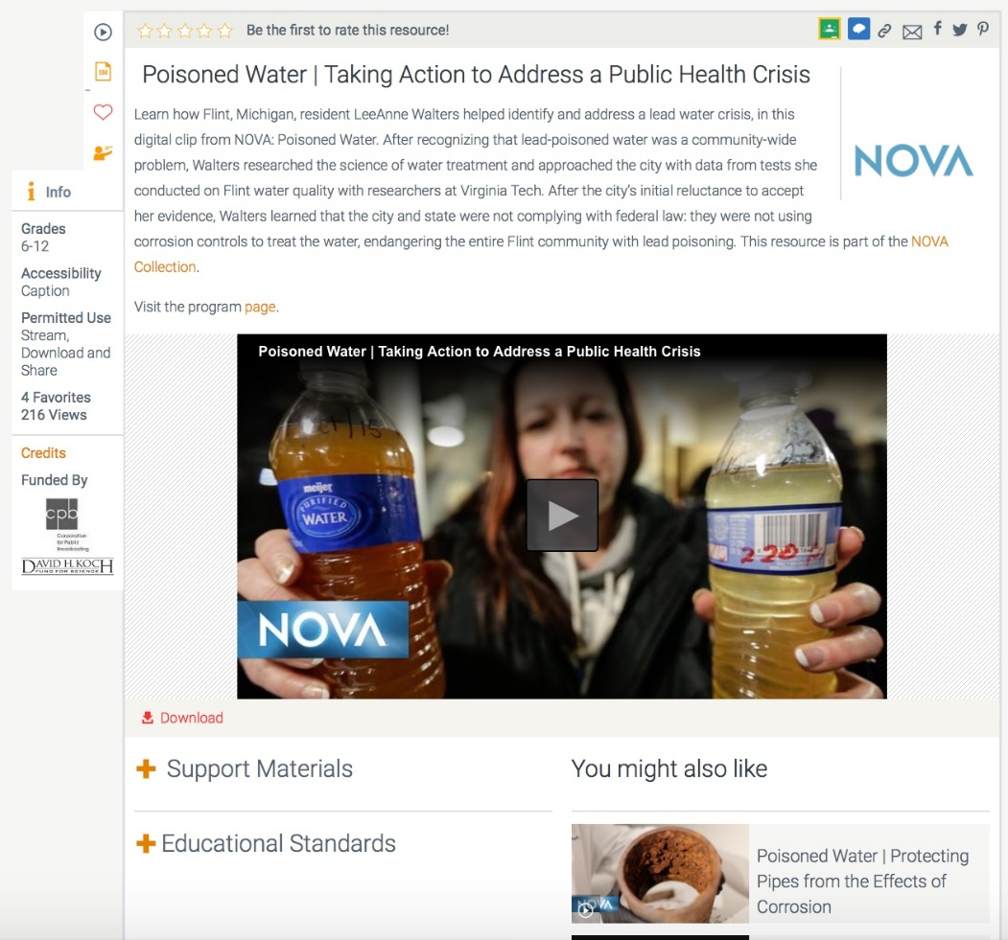
National Content — Local Relevance
4

Slide 6

Local Initiatives Shared Nationally
5

Slide 7






Collaboration Among Stations
6
Ruff Family Science
NSF-funded R&D Initiative
Exploring factors that support
family science learning through
joint media engagement
Resources will be developed for family and adult education programs

Slide 8


