Slide 1
Eric Wolf Vice President, Technology Strategy & Planning PBS

Slide 2
Next Gen TV – What are national orgs doing?
Lead Station Education
Facilitate Station Experiments
Socialize Next Gen

Slide 3
Next Gen TV – What should stations be doing?
Plan Purchasing Decisions
Equipment / Installation to become Next Gen ready (especially timely if one of 43% repacked, or factor into future capital campaign for infrastructure refresh if not repacked)
Initiate Local Discussions
Local in-market discussions with other stations (commercial and noncommercial) to gauge interest and potential for lighthouse partners, prior to any formal negotiations
Align to Station Strategy

Slide 4
Timeline
2018 | 2019 | 2020
Education Focus on developing Next Gen concepts and strategy Use in-person conferences to engage in strategic discussions | Experimentation Launch station pilots to test offerings Roll out simulcasting / licensing templates | Implementation Initial roll-out with alpha stations Consumer education

Slide 5
What if…? | Richer Content
Technical Capability | PTV Opportunity
High Dynamic Range video | Vivid, compelling experience
Updated audio | Control of voice and music tracks Vietnamese audio track
Interactivity | Press button to see map of place being discussed
Content downloads | Longer versions of interviews Material that had to be cut
Personalized, targeted content delivery | Seamlessly integrate local segments
Integration to mobile | Paired / synchronized experience on mobile while watching broadcast
Notes:
WOLF

Slide 6
What if…? | Audience Relationship
Technical Capability | PTV Opportunity
Personalization + Interactivity + Conditional access + Viewership data | Passport membership extends to broadcast “Pledge” becomes “Thank you” for members Seamless experience across platforms
 | Become or participate in OTA “skinny bundles” or other new models
 | Deeper understanding of both aggregate and individual viewership
Notes:
WOLF

Slide 7
What if…? | Kids & Interactivity
Technical Capability | PTV Opportunity
Deliver apps over-the-air | New content / functionality Even for people with no internet connection
TV apps use HTML 5.0 | PBS Kids web and mobile apps already built using HTML 5.0 May be able to deliver our most educational experience to every child even without broadband
Most TVs will be WiFi connected | Where connected, seamlessly extend PBS Kids ecosystem
Notes:
WOLF

Slide 8
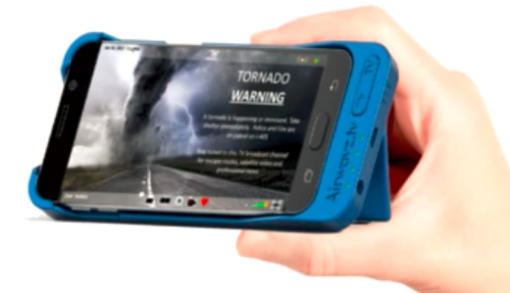
What if…? | Public Safety
Technical Capability | PTV Opportunity
Detailed data (e.g. maps) in alerts + Devices wake on alert | Increased importance to public safety community Increased value to audience
Geo-targeting | Increased relevance of local station Increased relevance to audience Opportunity to link to state / local alert systems
Targeting to mobile devices | Potential for consumer alerting Datacasting vital information to First Responders Reach where LTE does not cover
Notes:
WOLF

Slide 9
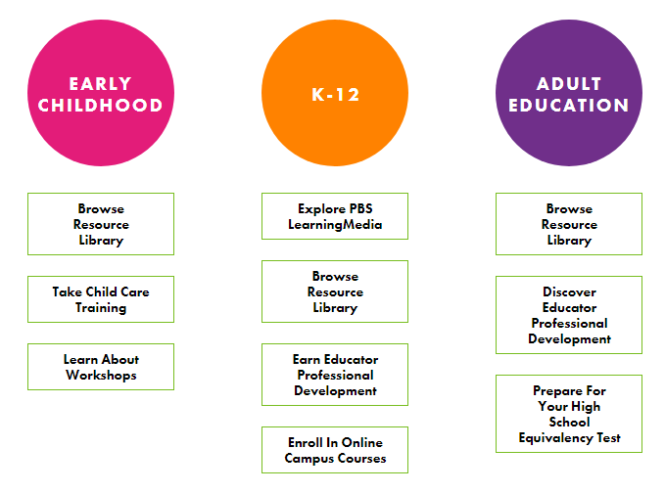
What if…? | Distance Learning
Technical Capability | PTV Opportunity
TVs run HTML 5 | Create rich applications that are distributed over the air and can combine broadcast and broadband content
Ability to pre-download targeted content OTA | Download the right lessons to the right classrooms Even if no / poor internet
Personalized content | Continuity back to home
Notes:
WOLF

