Slide 1
Next Gen Business and Technology Strategies
Dennis Wallace, C.B.T.E.
Meintel, Sgrignoli, & Wallace

Slide 2
Next Gen TV (ATSC3) = Flexibility
The “Ultimate” Swiss Army Knife
The System can be configured for a variety of business use cases
Stations decide which modes they use to support their use cases
Supports new business/use cases not previously available to stations
Key Differences ATSC1/ATSC3
Entirely IP system
Hybrid System OTA/OTT
RF Modulation (OFDM)
New Audio/Video Codecs
Flexibility to configure operating parameters

Slide 3
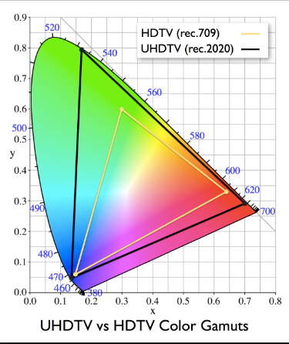
Supports “UHD Services”
HEVC
enables
4K resolution
Immersive Audio
AC-4
MPEG-H
High Dynamic Range
HLG
HDR10
Dolby Vision
Higher Frame Rate up to 120fps

Slide 4
Why Next Gen Applications
Integration of hybrid services (OTA/OTT)
Next Gen TV as an “Application” environment
Connection to internet enable interactivity in a more seamless way for viewers
HTML5
Fully compliant with W3C
Some extensions are added
Enables Non-Real Time content delivery – catch up viewing
Next Gen enables targeted content & services
Enables integration of other Pubic Media assets into variety of services for consumers

Slide 5
Next Gen Business
No longer limited to “TV Service” offerings
Opportunity to integrate other digital assets into “suite” of services
Opportunity to increase engagement with existing audiences
Opportunity to provide services/bandwidth to other entities
Opportunity for new programs, streams, & services
Future content creation will include integration of various assets
Tremendous Implications for educational, social, and cultural missions of Public Media

Slide 6
Next Gen Transition
No Government Mandate for transmission or reception – FCC has authorized transmission
Consumer adoption driven by value proposition to viewers
Most CE manufacturers have indicated that they plan to include both ATSC1/ATSC3 tuners in new sets
Market-Driven implementation on Market-By-Market Basis
Local broadcasters working together for Lighthouse build outs
Simulcasting requirements ATSC1/ATSC3 = Channel Sharing

Slide 7
Market Transitioning
ATSC 1 and ATSC 3 Channel Sharing Required in Each Market

Slide 8
Food for Thought…Next Steps
Start discussions with other stations in your market about Next Gen launch plans
Evaluate potential business implications for your organizations
New or Enhanced Services
Content Creation
Membership/Revenue Generation
Financial implications and costs
Technical and facilities planning: Both long and short term

